Slide 1


Best practices for data science on HPC
Geert Jan Bex
(geertjan.bex@uhasselt.be)
License: this presentation is released under the Creative Commons CC BY 4.0, see https://creativecommons.org/licenses/by/4.0/deed.ast

Slide 2

https://shorturl.at/Rb4Ni

Slide 3


Slide 4
Typographical conventions I
Inline code fragments and file names are rendered as, e.g., hello_world.py
Longer code fragments are rendered as
Data files are rendered as
#!/usr/bin/env python
…
if __name__ == '__main__':
print('hello world!')
case dim temp
1 1 -0.5
2 1 0.0
3 1 0.5
4 2 -0.5
…
fragment not shown

Slide 5





Typographical conventions II
Shell commands are rendered as
Do not type $, it represents your shell prompt!
Good practice:
Bad practice:
(Potential) hazards/bugs:
Performance issue:
Warning:
$ python –m doctest data_parsing.py

Slide 6
Introduction

Slide 7



Motivation: why use HPC?
Computation takes a lot of time
Large data set, not enough memory
Many different scenarios to compute
Or some
combination

Slide 8
Is it hard?
There is a learning curve
There are pitfalls
Extensive training catalog
Support is here to help
It's not rocket science either!

Slide 9
Set up your environment

Slide 10

How to manage your code?
Transfer back and forth?
Use version control!
https://gjbex.github.io/Version-control-with-git/

Slide 11



Data science software stack
Mainly
Python
R
Packages… many packages … more packages
Not exactly
HPC-ready
HPC-friendly
CRAN

Slide 12
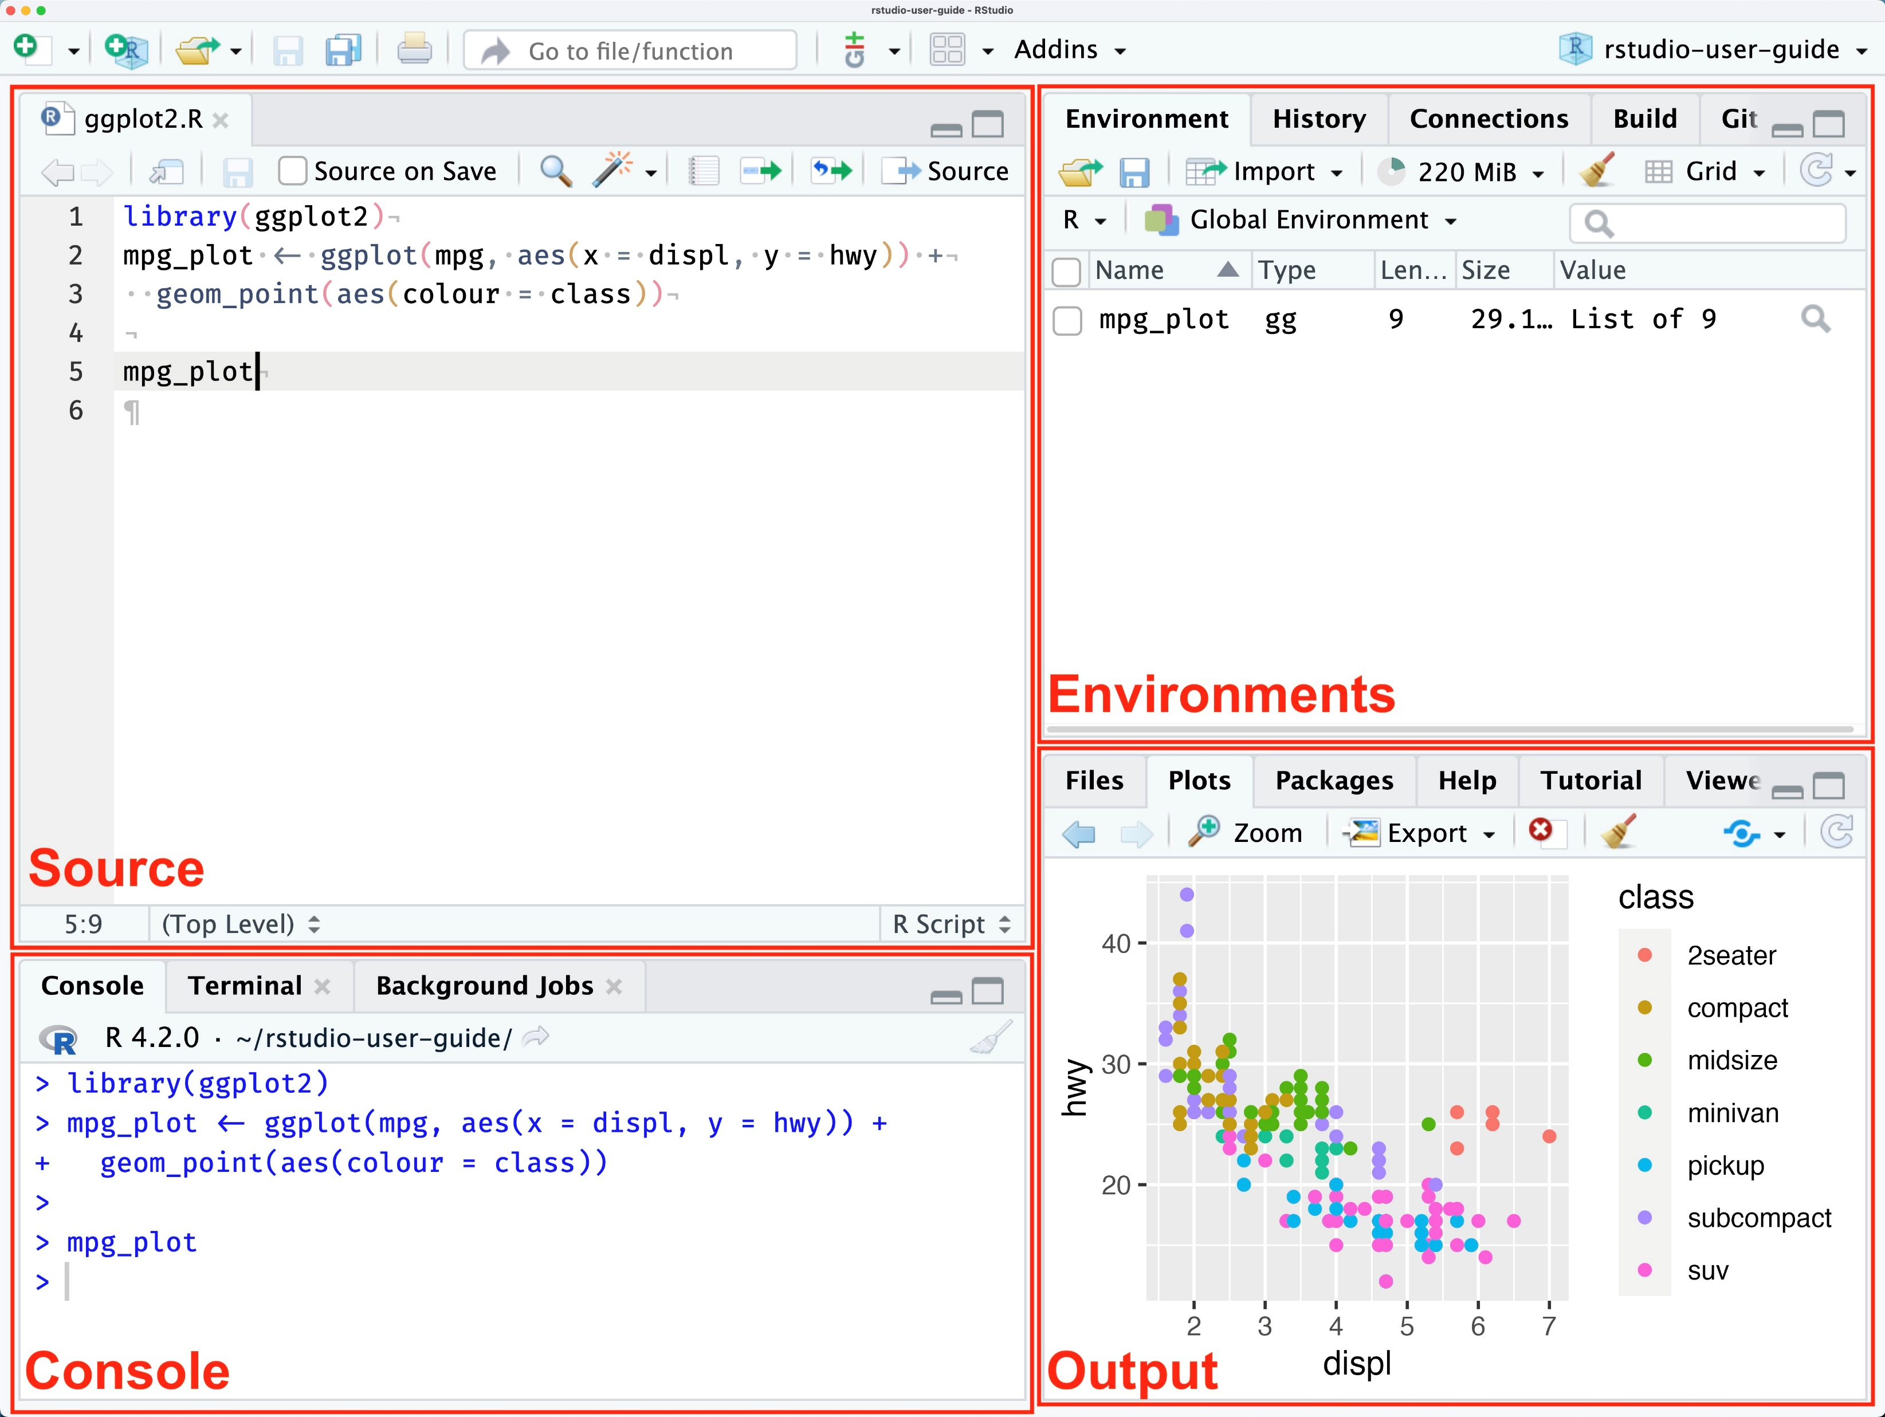
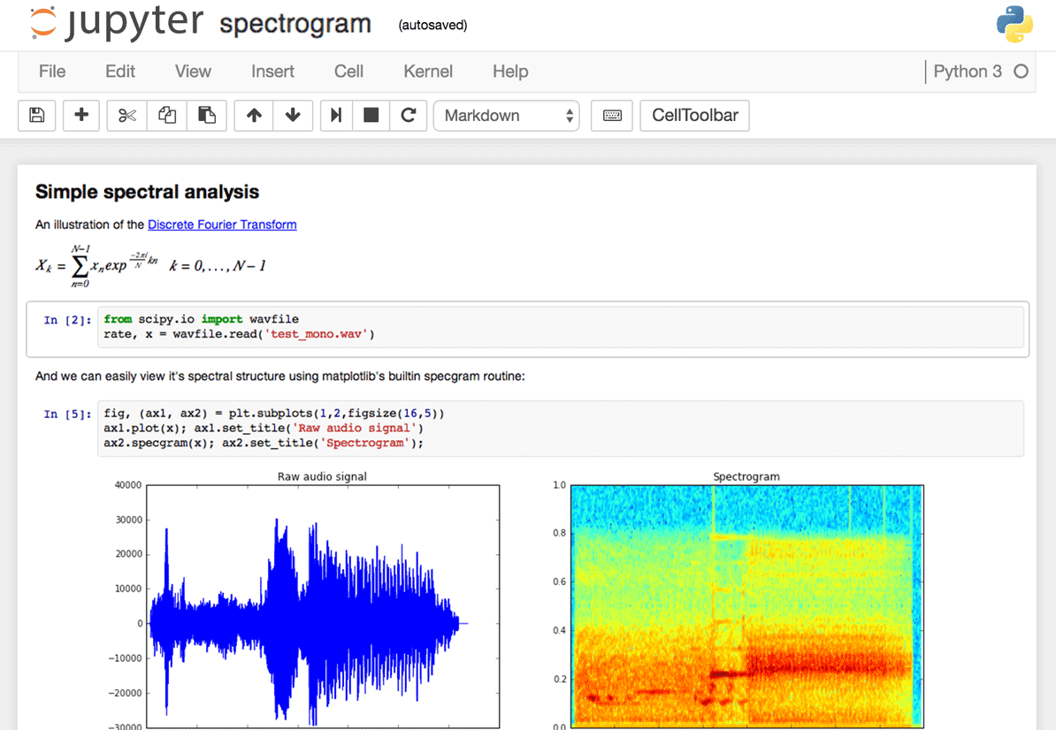
Modus operandi
$ python data_parsing.py
$ Rscript data_parsing.R
Transition from GUI/interactive to command line/batch

Slide 13
How to transition?
No absolute paths!
Values changed interactively → command line arguments
Python: use argparse/click
R: optparse
Choose/create your environment
"C:\Users\..."

Slide 14
Command line arguments

Slide 15
Python: argparse
…
Import argparse
…
parser = argparse.ArgumentParser(description='Compute cosine values.')
parser.add_argument('-n', '--num-points', type=int, default=100,
help='Number of points to compute')
parser.add_argument('-A', '--amplitude', type=float, default=1.0,
help='Amplitude of the cosine function')
parser.add_argument('-f', '--frequency', type=float, default=1.0,
help='Frequency of the cosine function')
…
args = parser.parse_args()
…
x, y = compute_cosine(args.num_points, args.amplitude, args.frequency)
…
cosine.py
Declare options
Handle options
Use option values
$ python cosine.py -n 100 --amplitude 2.5 …

Slide 16
R: optparse
…
library(optparse)
…
option_list <- list(
make_option(c("-c", "--city"), type = "character", help = "Name of the city to analyze weather data for"),
make_option(c("-q", "--quantity"), type = "character", default = "temp",
help = "Name of the quantity to analyze"),
make_option(c("-o", "--output"), type = "character",
help = "Path to the output CSV file")
)
opt <- parse_args(OptionParser(option_list = option_list))
if (dirname(opt$output) != ".") {
dir.create(dirname(opt$output), showWarnings = FALSE, recursive = TRUE)
}
…
weather_analysis.R
Declare options
Handle options
Use option values
$ Rscript weather_analysis.R -c London --output data_out.csv …

Slide 17
Environments

Slide 18

Options
Pre-installed modules
Install your own packages
Use containers
Not in scope: see https://gjbex.github.io/Containers-for-HPC/

Slide 19
Environment: modules

Slide 20
Modules
Use installed modules, when possible, e.g.,
R/4.4.0-gfbf-2023a
Python/3.12.3-GCCcore-13.3.0
Use package bundles, e.g.,
R-bundle-CRAN/2023.12-foss-2023a
SciPy-bundle/2024.05-gfbf-2024a
Use additional modules, e.g.,
TensorFlow/2.15.1-foss-2023a-CUDA-12.1.1
matplotlib/3.9.2-gfbf-2024a
Many, but likely not all

Slide 21
Job script & modules: best practices
#!/usr/bin/env -S bash -l
#SBATCH --account=<your_account>
#SBATCH --cluster=<your_cluster>
#SBATCH --time=00:02:00
…
# first clean up your environment
module purge &> /dev/null
# load only the modules you need
module load R-bundle-CRAN/2023.12-foss-2023a
…
jobscript.slurm
Reduces side effects
Ensures reproducability
Similar for Python

Slide 22
Python environments

Slide 23
Conda environments
Install conda
Create environment with numpy, matplotlib
Activate environment
Install additional packages
Update
$ wget https://repo.continuum.io/miniconda/Miniconda3-latest-Linux-x86_64.sh
$ bash Miniconda3-latest-Linux-x86_64.sh -b -p $VSC_DATA/miniconda3
$ source ~/.bashrc
$ conda create -n my_env numpy matplotlib
$ conda activate my_env
$ conda install pandas
$ conda update --all

Slide 24
Using conda environment
#!/usr/bin/env -S bash -l
#SBATCH --account=<your_account>
#SBATCH --cluster=<your_cluster>
#SBATCH --time=00:05:00
conda activate my_env
python cosine.py -n 100 -o result_${SLURM_JOB_ID}.txt \
-p plot_${SLURM_JOB_ID}.png
cosine.slurm
Activate environment

Slide 25
Conda
Best practices
Lean, single purpose environments
Keep under version control: reproducible
Keep laptop and HPC in sync: portability
Pitfall: installation directory, see documentation https://docs.vscentrum.be/compute/software/python_package_management.html
For performance on CPU, use Intel OneAPI distribution
$ conda list --explicit > environment_spec.txt
$ conda env export --from-history > environment.yml
$ conda create -n my_env -c intel intelpython3_full

Slide 26
R environments

Slide 27
R packages considerations
Packages built hardware-specific!
Install & use on same hardware
Installation on compute nodes
Packages built per R major release
Pure R packages: easy
Packages with library dependencies: not so easy
Use modules
Ask help if necessary

Slide 28
Interactive install: setup
Use OnDemand: interactive shell, or
From login node, submit interactive job
Load module
$ srun --account=<your-account> --time=00:30:00 \
--cluster=wice --partition=batch_sapphirerapids \
--pty /bin/bash -l
Hardware architecture
node $ module load R-bundle-CRAN/2023.12-foss-2023a

Slide 29
Interactive install: setup & install
Define installation location
Create the directory
Start R and install package(s)
node$ export R_LIBS_USER=$VSC_DATA/R/$VSC_OS_LOCAL/$VSC_ARCH_LOCAL/$EBVERSIONR
node $ mkdir -p $R_LIBS_USER
node $ R_LIBS_USER=$R_LIBS_USER R
> install.packages("dplyr")

Slide 30
Install in batch job
Do not underestimate walltime
#!/usr/bin/env -S bash -l
#SBATCH --account=<your_account>
#SBATCH --time=00:30:00
#SBATCH --cpus-per-task=4
module purge &> /dev/null
module load R-bundle-CRAN/2023.12-foss-2023a
export R_LIBS_USER="${VSC_DATA}/R/${VSC_OS_LOCAL}/${VSC_ARCH_LOCAL}/${EBVERSIONR}"
LOG_FILE="install_${VSC_OS_LOCAL}_${VSC_ARCH_LOCAL}_${EBVERSIONR}.log"
mkdir -p $R_LIBS_USER
R_LIBS_USER=$R_LIBS_USER R --no-save &> $LOG_FILE <<EOI
options(repos = c(CRAN = "https://cloud.r-project.org"))
install.packages("dplyr")
EOI
install_r_packages.slurm
Load R module
Create directory if necessary
List of packages to install
$ sbatch --cluster=wice --partition=batch_sapphirerapids install_r_packages.slurm

Slide 31
Using R environment
#!/usr/bin/env -S bash -l
#SBATCH --account=<your_account>
#SBATCH --cluster=<your_cluster>
#SBATCH --time=00:05:00
module purge &> /dev/null
module load R-bundle-CRAN/2023.12-foss-2023a
export R_LIBS_USER="${VSC_DATA}/R/${VSC_OS_LOCAL}/${VSC_ARCH_LOCAL}/${EBVERSIONR}"
R_LIBS_USER=$R_LIBS_USER Rscript hello_world_cla.R
cosine.slurm
Ensures right environment

Slide 32
Walltime & runtime?

Slide 33
How much time do you need?
Specify --time=d-HH:MM:SS
How much?
Don't underestimate!
Don't (massively) overestimate!
Experiment: benchmark
Start with "small" problem
Increase problem size gradually
Extrapolate to real problem
time
size
Clock frequencies compute node < laptop

Slide 34
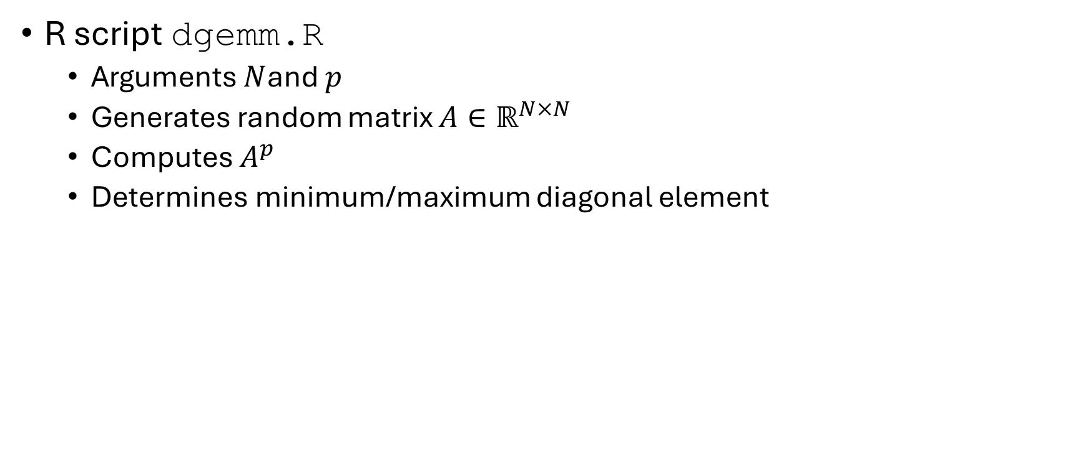
Running example
R script dgemm.R
Arguments $N$and $p$
Generates random matrix $A∈ℝ^{N×N}$
Computes $A^{p}$
Determines minimum/maximum diagonal element
$ Rscript dgemm.R --size 1000 --power 15

Slide 35
Benchmark job script
#!/usr/bin/env -S bash -l
#SBATCH --account=<your_account>
#SBATCH --cluster=<your_cluster>
#SBATCH --partition=<your_partition>
#SBATCH --ntasks=1
#SBATCH --cpus-per-task=1
#SBATCH --time=00:05:00
module purge &> /dev/null
module load R-bundle-CRAN/2023.12-foss-2023a
export R_LIBS_USER="${VSC_DATA}/R/${VSC_OS_LOCAL}/${VSC_ARCH_LOCAL}/${EBVERSIONR}"
R_LIBS_USER=$R_LIBS_USER Rscript dgemm.R --size $SIZE --power $POWER
memory_and_walltime.slurm
Parameters to vary

Slide 36
Running benchmark
Submit benchmark jobs
Get resources used
$ sbatch --export=ALL,SIZE=5000,POWER=10 memory_and_walltime.slurm
$ sbatch --export=ALL,SIZE=5000,POWER=20 memory_and_walltime.slurm
$ sbatch --export=ALL,SIZE=5000,POWER=40 memory_and_walltime.slurm
$ sbatch --export=ALL,SIZE=10000,POWER=10 memory_and_walltime.slurm
$ sbatch --export=ALL,SIZE=10000,POWER=20 memory_and_walltime.slurm
…
$ sacct --cluster=<your_cluster> --jobs=<your_job_id>.batch \
--format=jobid,elapsed,maxrss,maxvmsize
…

Slide 37
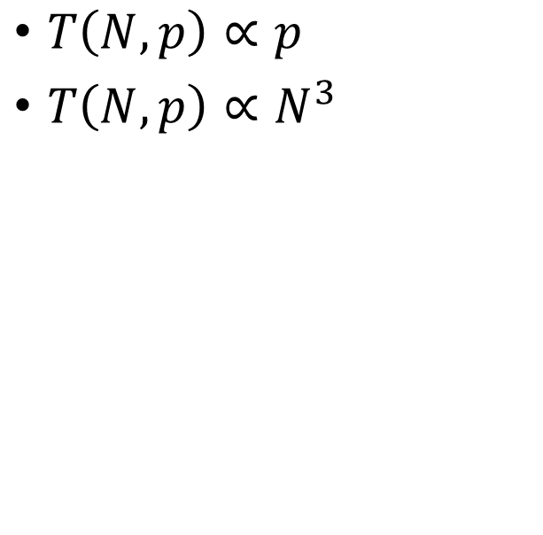
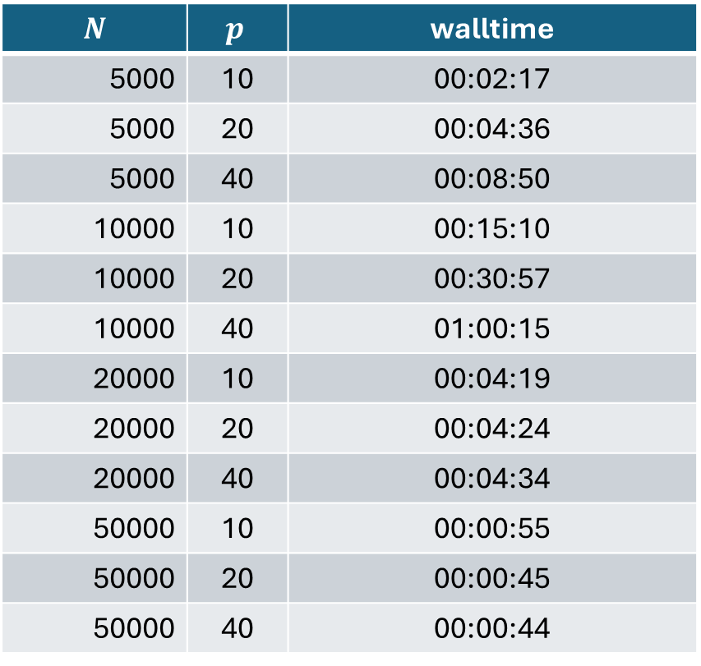
Walltime benchmark results
$$N$$ | $$p$$ | walltime
5000 | 10 | 00:02:17
5000 | 20 | 00:04:36
5000 | 40 | 00:08:50
10000 | 10 | 00:15:10
10000 | 20 | 00:30:57
10000 | 40 | 01:00:15
20000 | 10 | 00:04:19
20000 | 20 | 00:04:24
20000 | 40 | 00:04:34
50000 | 10 | 00:00:55
50000 | 20 | 00:00:45
50000 | 40 | 00:00:44
Scaling
$T\left(N, p\right)∝p$
$T\left(N, p\right)∝N^{3}$
What happened?
What happened?

Slide 38
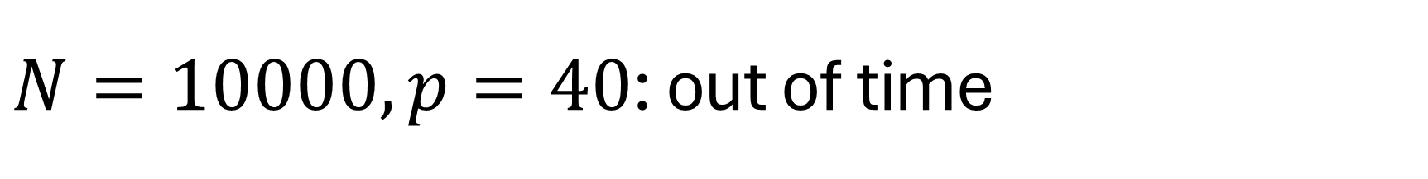
$N=10000, p=40$: out of time
Inspect job output
…
Walltime: 00-01:00:00
========================================================================
…
slurmstepd: error: *** JOB 62199209 ON q16c03n1 CANCELLED
AT 2024-08-13T18:28:16 DUE TO TIME LIMIT ***
slurm-62199209.out
No output, 1 hour of computations lost!

Slide 39
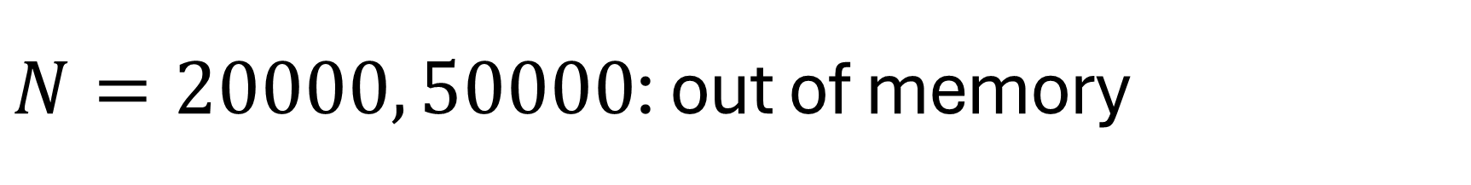
$N=20000, 50000$: out of memory
Inspect job output
…
Walltime: 00-01:00:00
========================================================================
…
slurmstepd: error: Detected 1 oom_kill event in StepId=62199210.batch.
Some of the step tasks have been OOM Killed.
slurm-62199210.out

Slide 40
Specify memory requirements
Check available memory/node (typically 256 GB RAM) https://docs.vscentrum.be/compute/tier2.html
Total memory per job: --mem mem < RAM - 8 GB
Memory per core: --mem-per-cpu ntasks × cpus-per-task × mem-per-cpu < RAM - 8 GB
Units: K, M, G, T
…
#SBATCH --mem=15G
…

Slide 41
How much memory do you need?
Specify --mem
How much?
Don't underestimate!
Don't (massively) overestimate!
Experiment: benchmark
Start with "small" problem
Increase problem size gradually
Extrapolate to real problem
memory
size

Slide 42
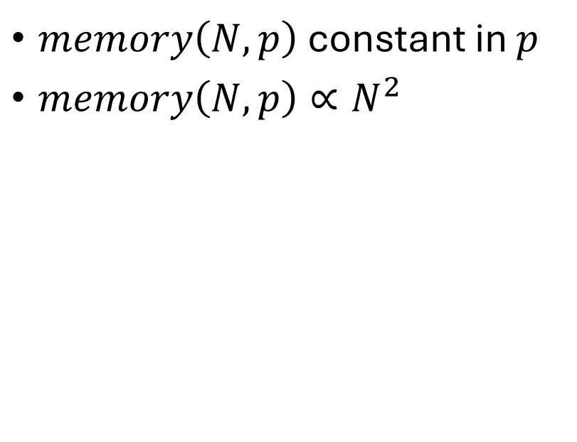
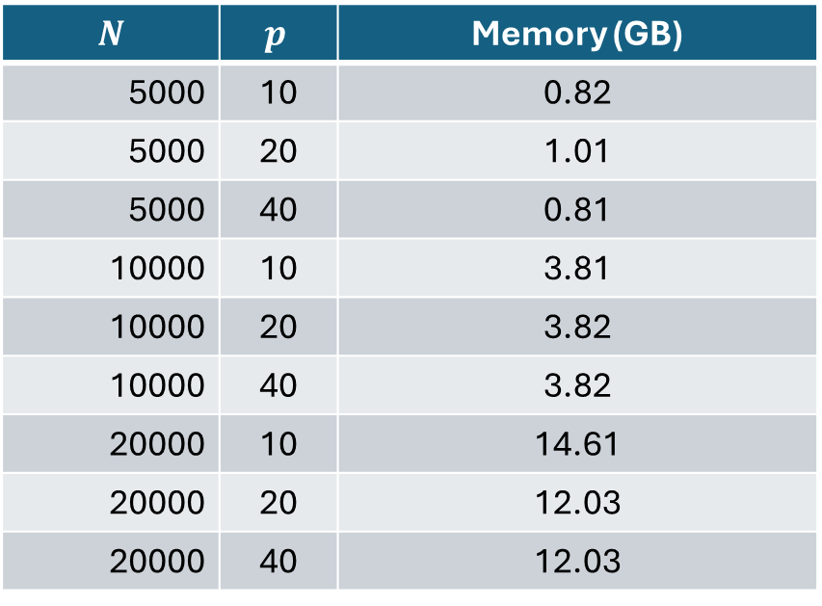
Memory benchmark results
$$N$$ | $$p$$ | Memory (GB)
5000 | 10 | 0.82
5000 | 20 | 1.01
5000 | 40 | 0.81
10000 | 10 | 3.81
10000 | 20 | 3.82
10000 | 40 | 3.82
20000 | 10 | 14.61
20000 | 20 | 12.03
20000 | 40 | 12.03
Scaling
$memory\left(N, p\right)$ constant in $p$
$memory\left(N, p\right)∝N^{2}$

Slide 43
Walltime & memory: conclusions
Do not underestimate: waste of resources
Do not overestimate (too much): inefficient
Only benchmark when relevant
Long walltimes
Lots of memory
Many runs

Slide 44
Efficiency

Slide 45
Implicit parallelism
Parallelism "under the hood"
Some R functions/operations, e.g.,
Some Python libraries, e.g.,
Numpy
How to know?
Check documentation
Measure
…
A <- matrix(rnorm(25), nrow=5)
result <- A
for (i in 1:(power-1)) {
result <- result %*% A
}
…

Slide 46

Benchmark environment
Sapphire Rapids node
2 Intel Xeon Platinum 8468 48-core CPUs
256 GB RAM
Environment: R/4.4.0-gfbf-2023a

Slide 47
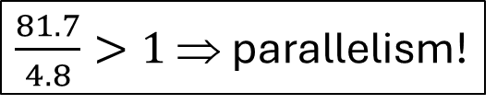
Parallel or not?
Time R script execution
…
#SBATCH --cpus-per-task=16
…
export R_LIBS_USER="${VSC_DATA}/R/${VSC_OS_LOCAL}/${VSC_ARCH_LOCAL}/${EBVERSIONR}"
time R_LIBS_USER=$R_LIBS_USER Rscript dgemm.R --size 5000 --power 20
memory_and_walltime.slurm
…
real 0m4.791s
user 1m21.693s
sys 0m31.345s
…
slurm-….out
$\frac{81.7}{4.8}>1$ ⇒ parallelism!

Slide 48
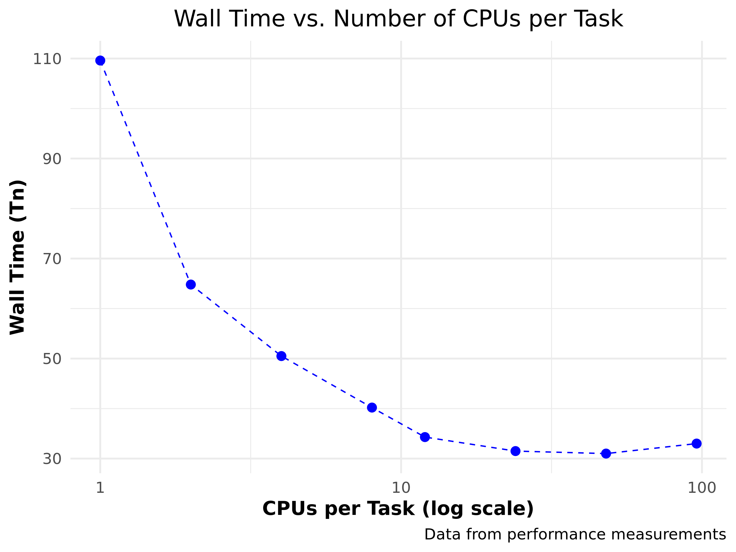

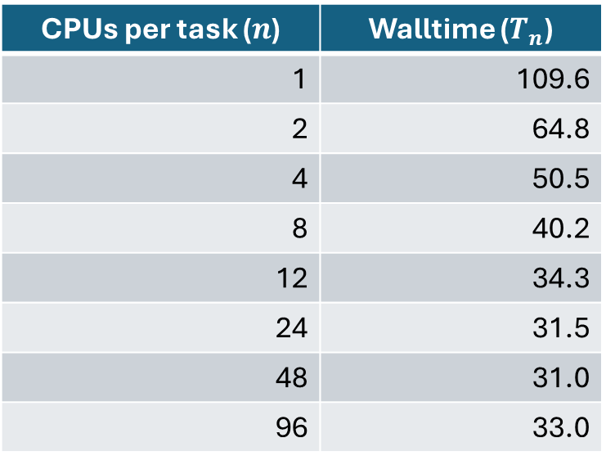
How to exploit?
Use --cpus-per-task 1 ≤ cpus-per-task ≤ number of cores
CPUs per task ($n$) | Walltime ($T_{n}$)
1 | 109.6
2 | 64.8
4 | 50.5
8 | 40.2
12 | 34.3
24 | 31.5
48 | 31.0
96 | 33.0

Slide 49
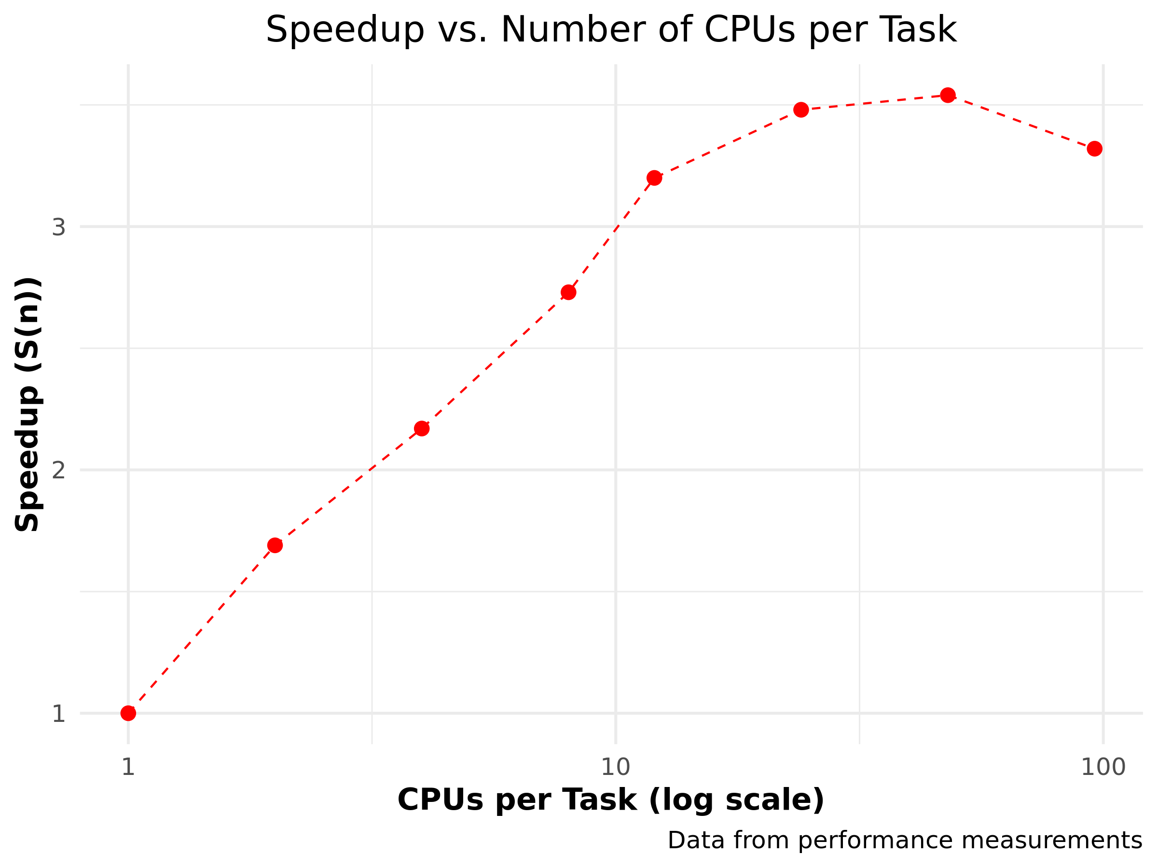

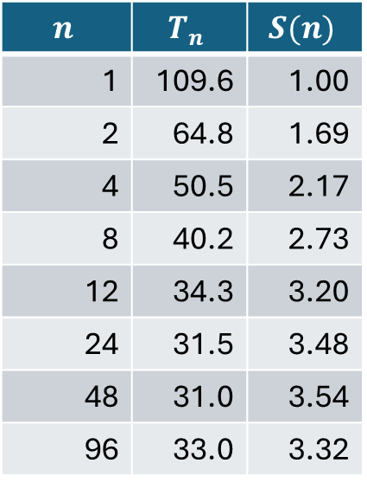
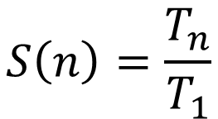
Speedup
$$S\left(n\right)=\frac{T_{n}}{T_{1}}$$
$$n$$ | $$T_{n}$$ | $$S(n)$$
1 | 109.6 | 1.00
2 | 64.8 | 1.69
4 | 50.5 | 2.17
8 | 40.2 | 2.73
12 | 34.3 | 3.20
24 | 31.5 | 3.48
48 | 31.0 | 3.54
96 | 33.0 | 3.32

Slide 50
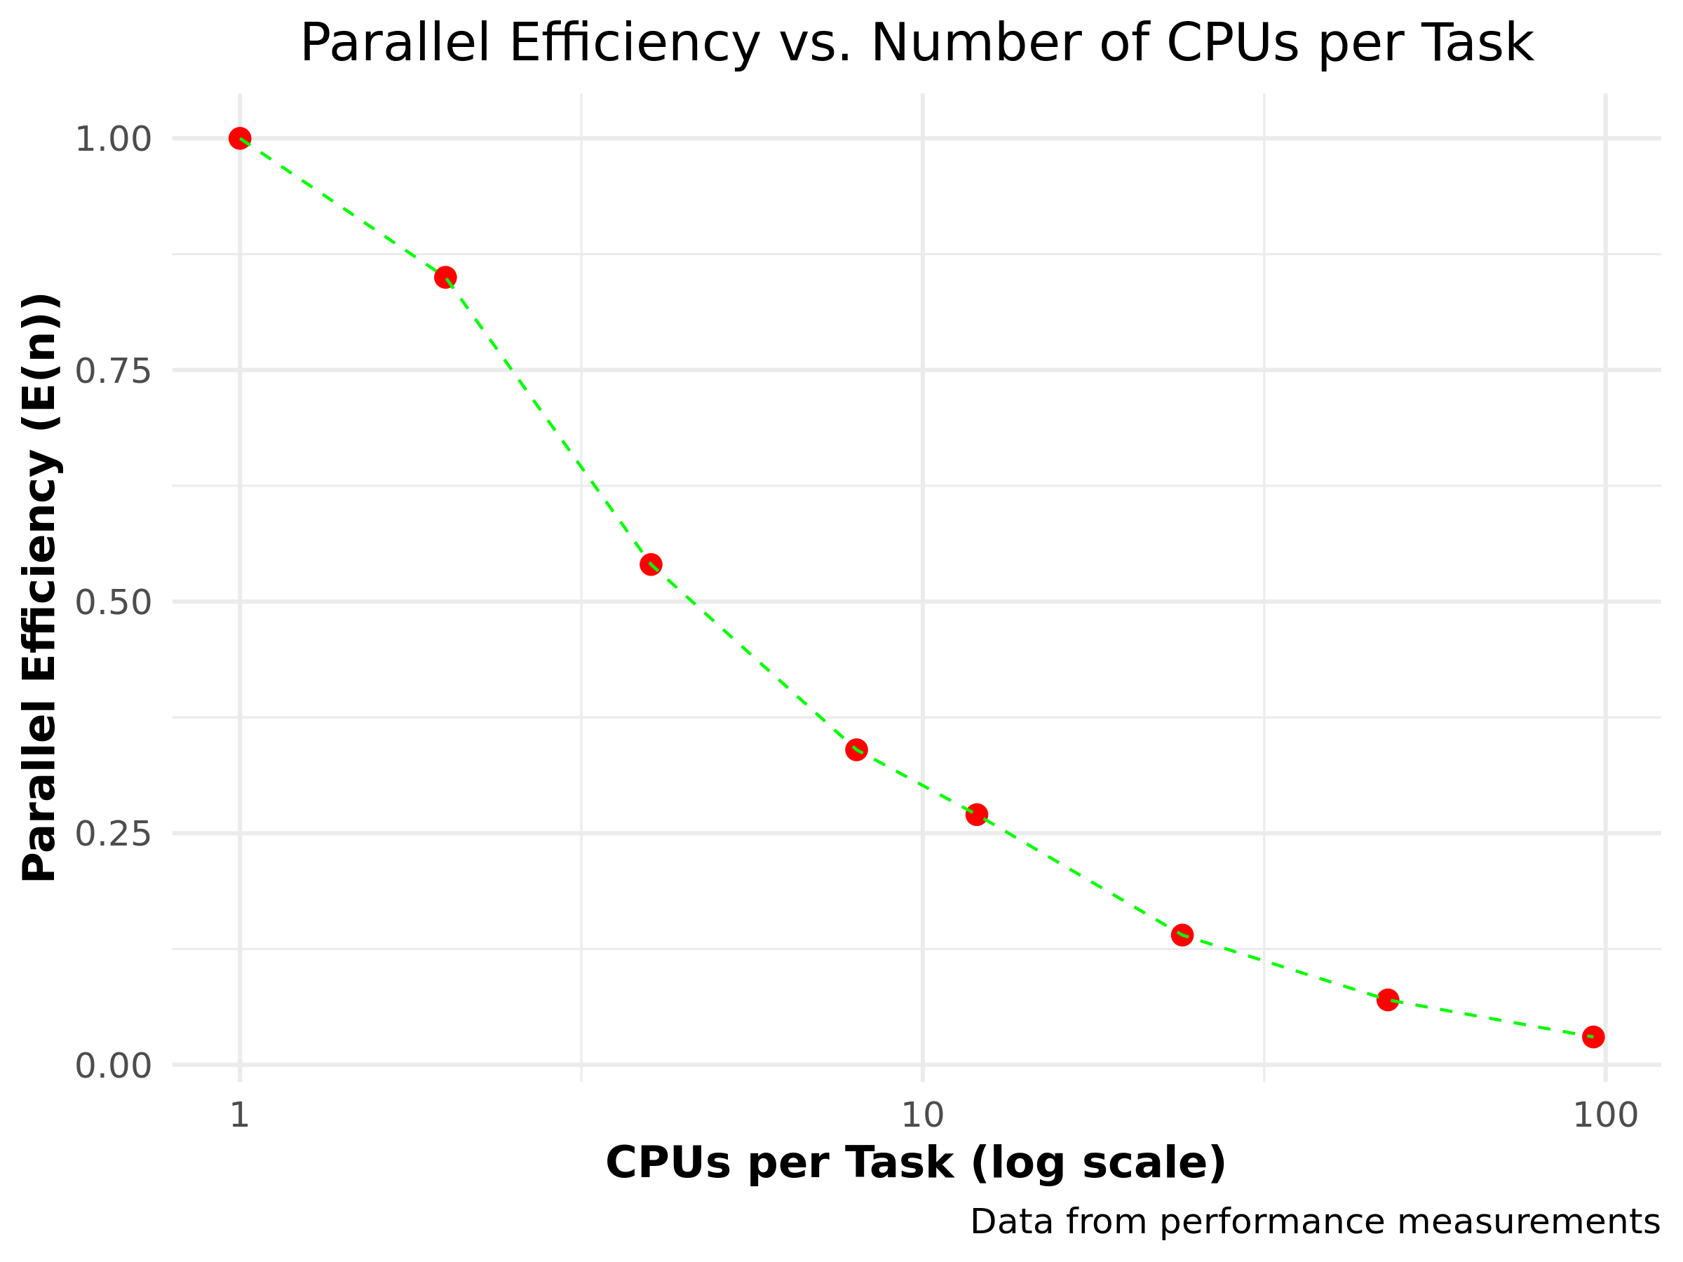

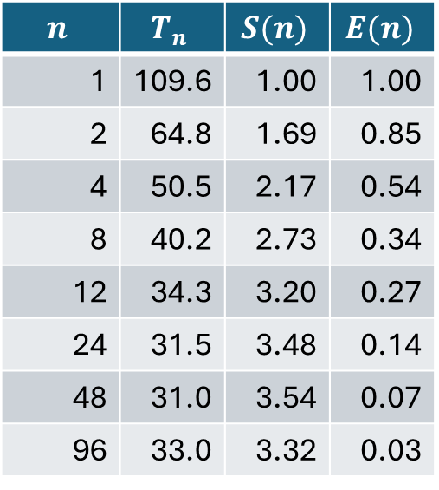
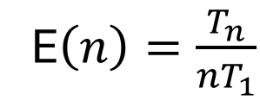
Parallel efficiency
E$\left(n\right)=\frac{T_{n}}{{nT}_{1}}$
$$n$$ | $$T_{n}$$ | $$S(n)$$ | $$E(n)$$
1 | 109.6 | 1.00 | 1.00
2 | 64.8 | 1.69 | 0.85
4 | 50.5 | 2.17 | 0.54
8 | 40.2 | 2.73 | 0.34
12 | 34.3 | 3.20 | 0.27
24 | 31.5 | 3.48 | 0.14
48 | 31.0 | 3.54 | 0.07
96 | 33.0 | 3.32 | 0.03

Slide 51
Parallel scaling

Slide 52
Dimensions for scaling
Scaling considered in two dimensions
solve same problem faster by using more resources
solve larger problem by using more resources
Strong scaling
Weak scaling

Slide 53
What you hope/expect for…
strong scaling
weak scaling
execution time
nr. processes
Is this going
to happen?
system size
execution time ∼
nr. processes

Slide 54
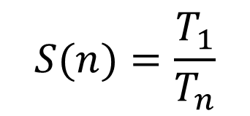
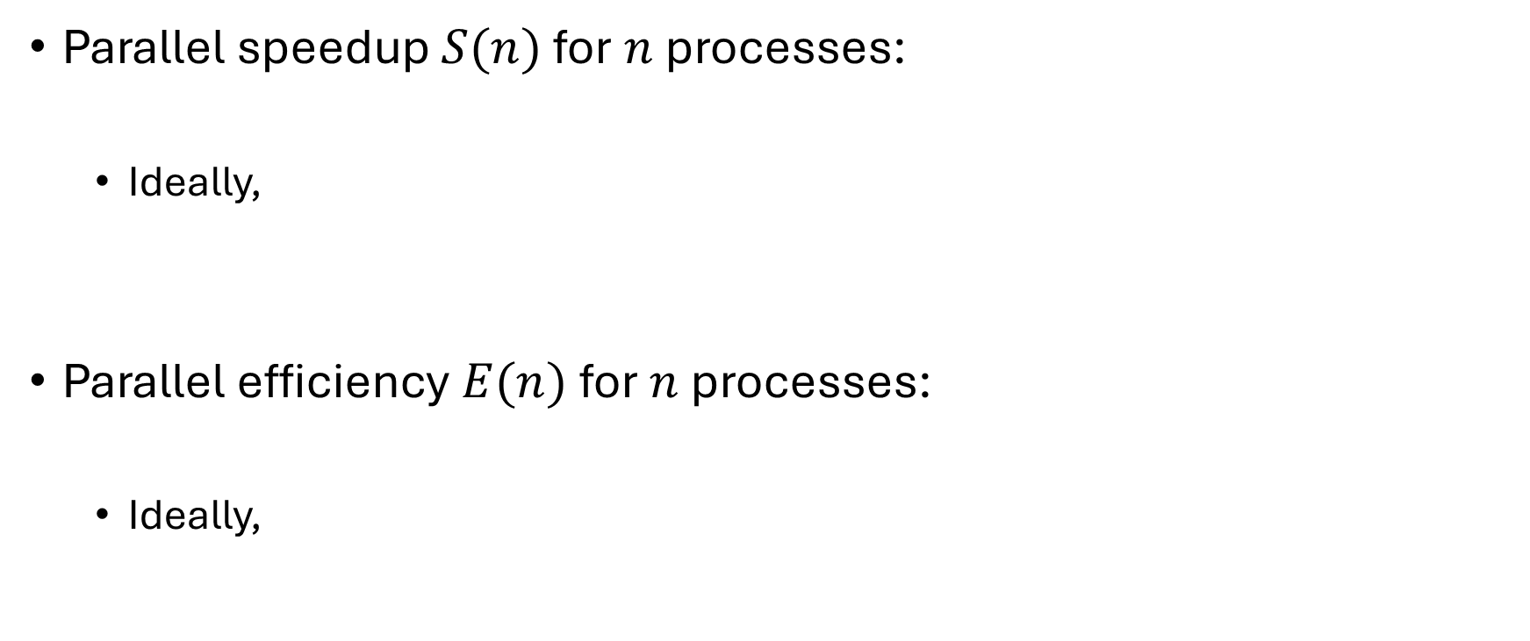
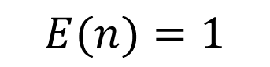
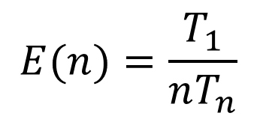
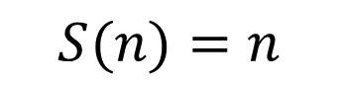
Definitions
Parallel speedup $S(n)$ for $n$ processes:
Ideally,
Parallel efficiency $E(n)$ for $n$ processes:
Ideally,
$$S(n)=\frac{T_{1}}{T_{n}}$$
$$S(n)=n$$
$$E(n)=\frac{T_{1}}{nT_{n}}$$
$$E(n)=1$$

Slide 55
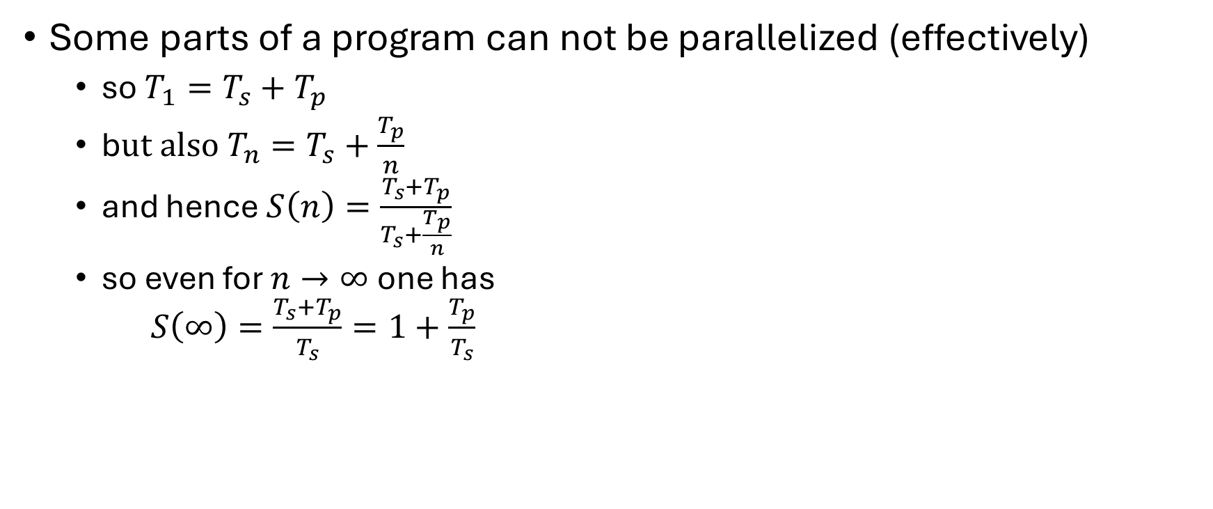
Strong scaling: oops!?!
Some parts of a program can not be parallelized (effectively)
so $T_{1}=T_{s}+T_{p}$
b$ut also T_{n}=T_{s}+\frac{T_{p}}{n}$
and hence $S\left(n\right)=\frac{T_{s}+T_{p}}{T_{s}+\frac{T_{p}}{n}}$
so even for $n→∞$ one has $S\left(∞\right)=\frac{T_{s}+T_{p}}{T_{s}}=1+\frac{T_{p}}{T_{s}}$
Hard limit on speedup due to serial part: Amdahl's law

Slide 56
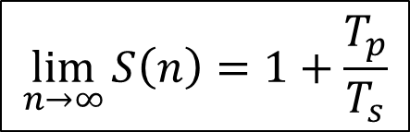
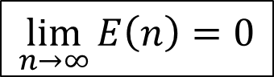
Amdahl's law
speedup
nr. processes
$$\lim_{n→∞}{S\left(n\right)=1+\frac{T_{p}}{T_{s}}}$$
$$\lim_{n→∞}{E\left(n\right)=0}$$

Slide 57
It gets worse…
Overhead!
communication takes time
finite bandwidth
non-zero latency
resource contention
memory subsystem: L3 cache, RAM, QPI
network access
speedup
nr. processes

Slide 58
Picking the sweet spot
sweet spot
speedup
sweet spot
nr. processes
efficiency
nr. processes

Slide 59
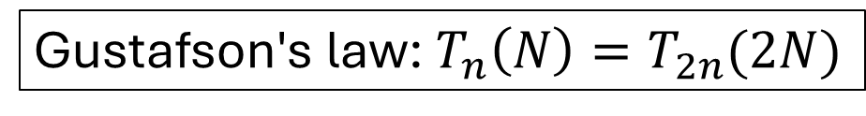
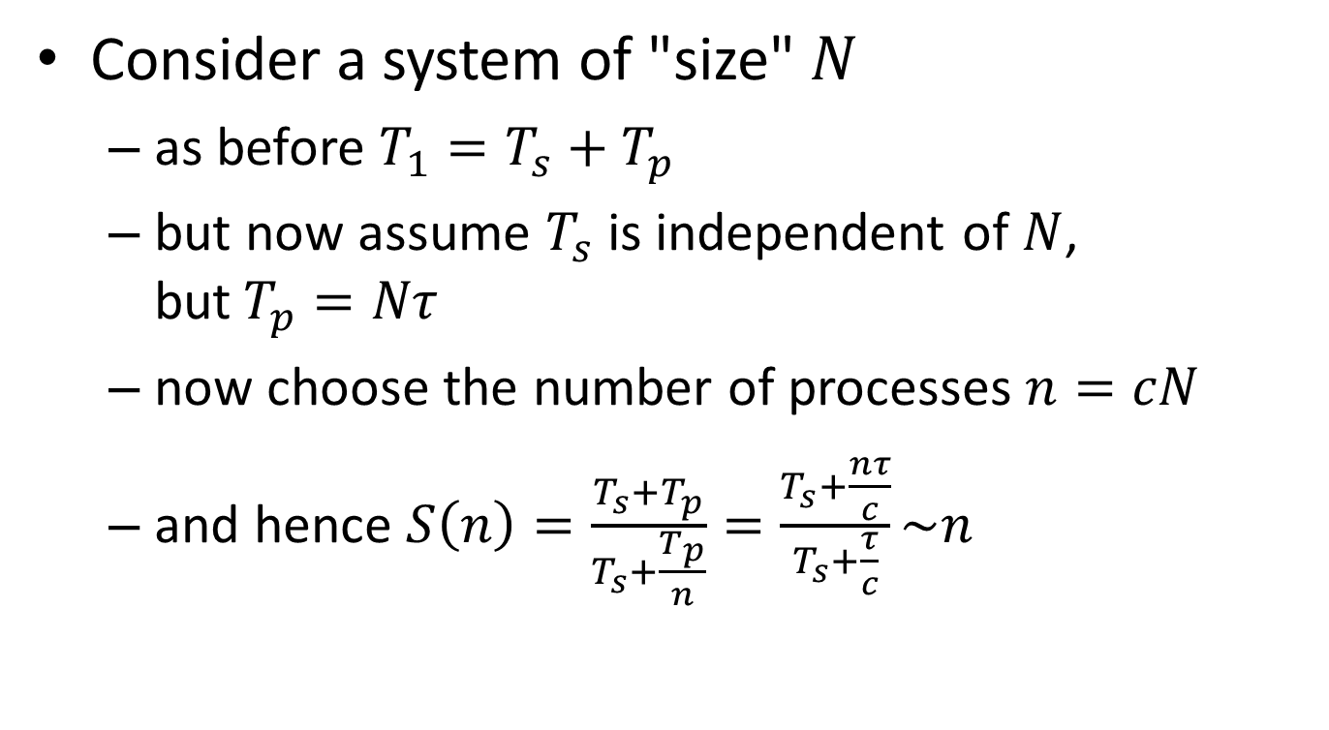
Weak scaling
Consider a system of "size" $N$
as before $T_{1}=T_{s}+T_{p}$
but now assume $T_{s}$ is independent of $N$, but$T_{p}=Nτ$
now choose the number of processes $n=cN$
and hence $S\left(n\right)=\frac{T_{s}+T_{p}}{T_{s}+\frac{T_{p}}{n}}=\frac{T_{s}+\frac{nτ}{c}}{T_{s}+\frac{τ}{c}}\sim n$
Nice for scientists!
Gustafson's law: $T_{n}\left(N\right)=T_{2n}(2N)$

Slide 60
We love Gustafson
Scientist are interested in
studying larger systems/bigger data sets
increasing precision/resolution
more complex phenomena
…

Slide 61
Throughput computing

Slide 62

What is it?
Same or similar computation
On many different input files
With many different parameter settings
B
Very common in data science
A

Slide 63
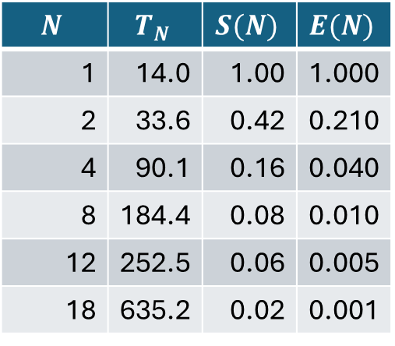
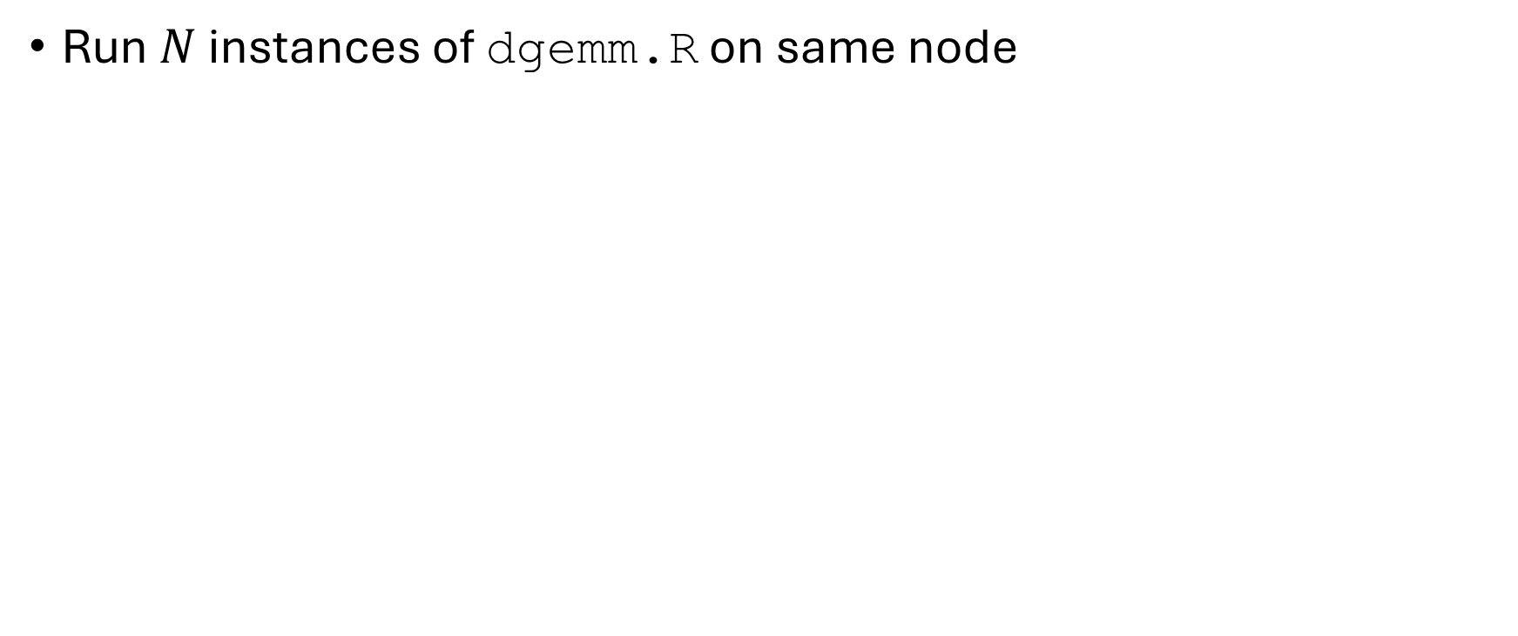
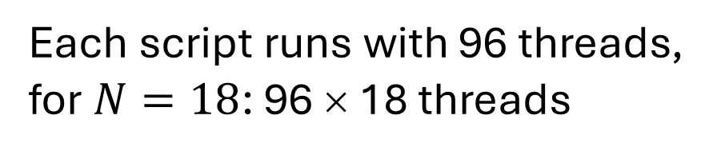
Lots of matrices…
Run $N$ instances of dgemm.R on same node
$$N$$ | $$T_{N}$$ | $$S(N)$$ | $$E(N)$$
1 | 14.0 | 1.00 | 1.000
2 | 33.6 | 0.42 | 0.210
4 | 90.1 | 0.16 | 0.040
8 | 184.4 | 0.08 | 0.010
12 | 252.5 | 0.06 | 0.005
18 | 635.2 | 0.02 | 0.001
Worse than serial?!?
Each script runs with 96 threads, for $N=18$: 96 × 18 threads
Massive oversubscription: 1728 threads >> 96 cores

Slide 64
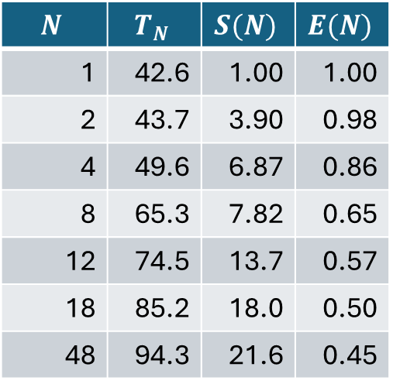
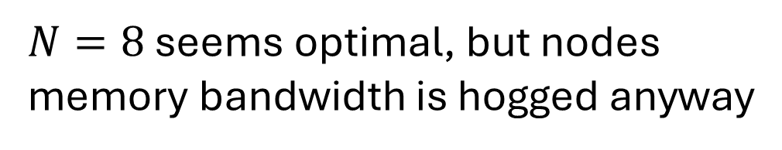
Control number of threads
Set OMP_NUM_THREADS=2
$$N$$ | $$T_{N}$$ | $$S(N)$$ | $$E(N)$$
1 | 42.6 | 1.00 | 1.00
2 | 43.7 | 3.90 | 0.98
4 | 49.6 | 6.87 | 0.86
8 | 65.3 | 7.82 | 0.65
12 | 74.5 | 13.7 | 0.57
18 | 85.2 | 18.0 | 0.50
48 | 94.3 | 21.6 | 0.45
$N=8$ seems optimal, but nodes memory bandwidth is hogged anyway
Not always via OMP_NUM_THREADS, check documentation!

Slide 65
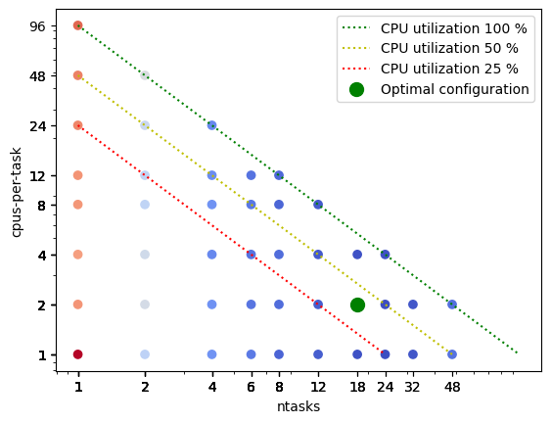
The whole picture
Vary both
Number of tasks
Number of CPUs/task
Here
Number of tasks = 18
CPUs per task = 2

Slide 66
Know thy software!
renv creates sandbox environment
Slows down startup of R interpreter
Nearly "serializes" startup of R interpreters
…
Warning message:
renv took longer than expected (11 seconds) to activate the sandbox.
The sandbox can be disabled by setting:
RENV_CONFIG_SANDBOX_ENABLED = FALSE
within an appropriate start-up .Renviron file.
See `?renv::config` for more details.…

Slide 67
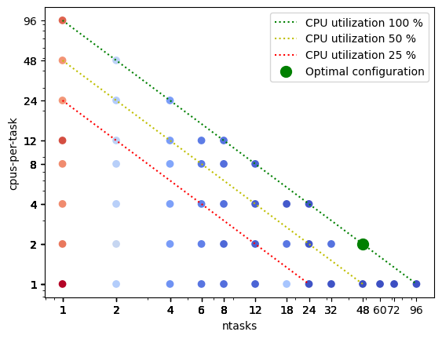
The whole, better picture
Vary both
Number of tasks
Number of CPUs/task
Here
Number of tasks = 48
CPUs per task = 2

Slide 68
Why performance degradation?
Memory architecture!
48 core Intel Sapphire Rapids
256 GB RAM, 8 memory channels at 4800 GHz
L3 cache per socket: 105 MB (shared, 2.2 MB/core)
L2 cache per core: 2 MB
L1 cache per core: 48 kB data
36 core Intel Icelake
256 GB RAM, 8 memory channels at 3200 GHz
L3 cache per socket: 54 MB (shared, 1.5 MB/core)
L2 cache per core: 1.25 MB
L1 cache per core: 48 kB data

Slide 69
Bottlenecks
Applications can be
Memory bound
Compute bound
I/O bound
Benchmark!
time in job script
hyperfine in jobscript
Gathers statistics over multiple runs
Can compare multiple commands
For completed job

Slide 70
Throughput computing
N independent tasks
Total number of cores n << N
Execution time single task, 1 thread: t₁
Execution time single task, n threads: t_{n}
Multithreading or not?
However: memory?

Slide 71
Workflows

Slide 72
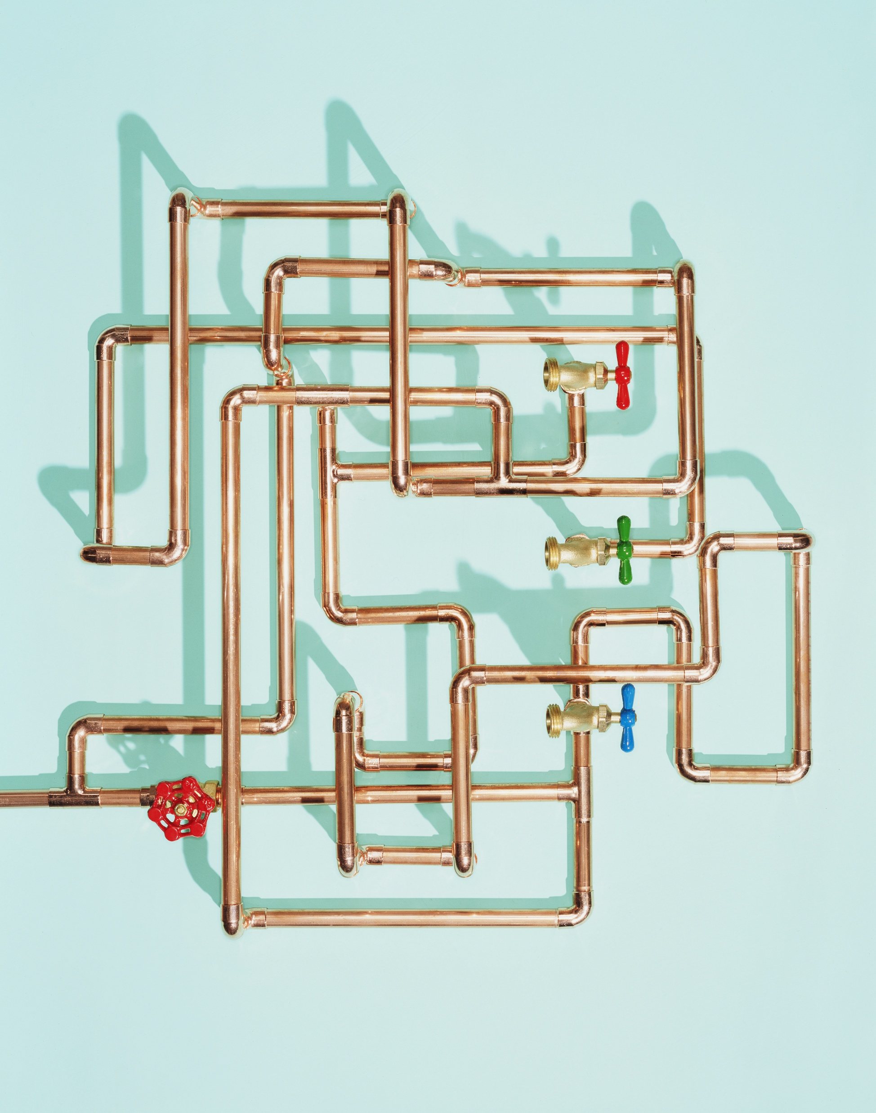
Many tools
Scheduler
Workflow managers
https://gjbex.github.io/Workflows-for-HPC/

Slide 73
Performance optimization

Slide 74
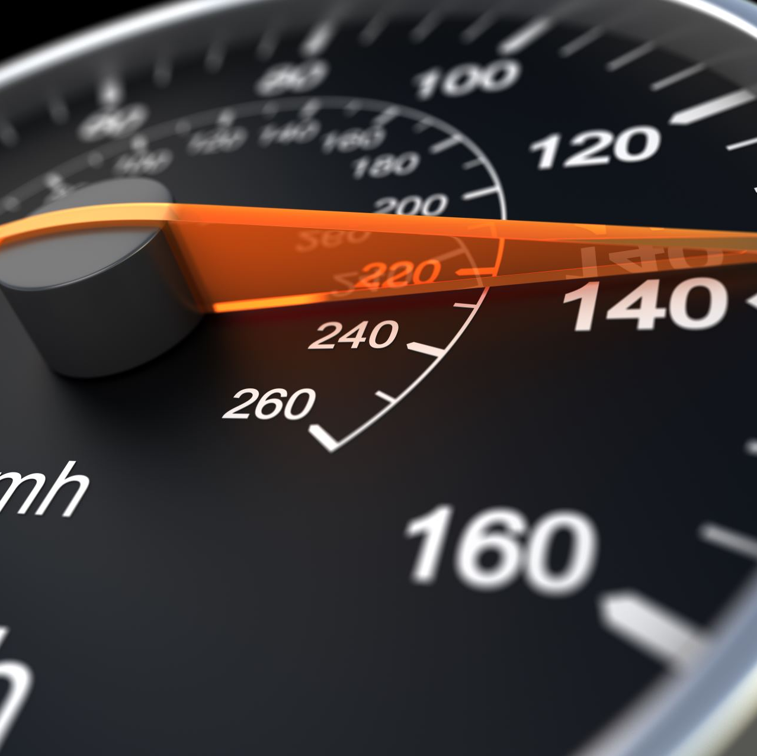
Where to start?
Gut feeling?
Best guess?
Easy to optimize?
Run a profiler!

Slide 75
Profilers
Python
%time/%timeit in notebooks, timeit module (standard library)
py-spy sampling profiler
cProfile module (standard library, visualize using snakeviz
line_profiler
mem_prof
R
Rprof

Slide 76
Profiling Python scripts

Slide 77
Timing functions
Ipython/Jupyter: use magic %time or %timeit
Command line: use timeit module
In [1]: from primes import primes
In [2]: %timeit result = primes(1000)
10 loops, best of 3: 172 ms per loop
multiple runs
timing result
module to use
statements to execute, string per line
$ python -m timeit 'from primes import primes' 'primes(1000)'
10 loops, best of 3: 174 msec per loop
Don't forget indentation!

Slide 78
cProfiler
Use the cProfile module
module to use
sort order
$ python -m cProfile -s time primes.py 1000
2914 function calls (2878 primitive calls) in 0.261 seconds
Ordered by: internal time
ncalls tottime percall cumtime percall filename:lineno(function)
1 0.250 0.250 0.251 0.251 primes.py:6(primes)
1 0.002 0.002 0.002 0.002 {built-in method loads}
1194 0.001 0.000 0.001 0.000 {'append' of 'list'}
43 0.001 0.000 0.001 0.000 {'join' of 'str'}

Slide 79

Visualize cProfile profiles: snakeviz
Use the cProfile module, save profile
output file
$ python -m cProfile -s time -o primes.prof \ primes.py 1000
call stack "inside-out"
$ snakeviz primes.prof

Slide 80
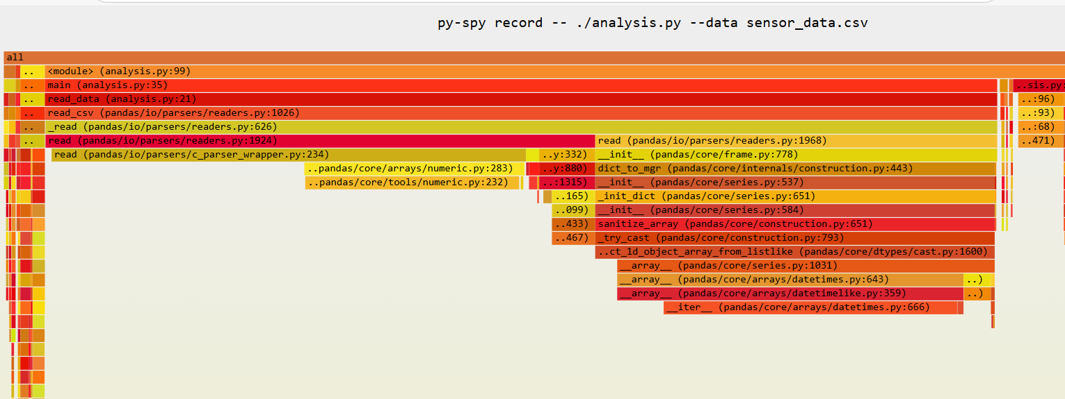
Sampling profiling: py-spy
Create profile
Open interactive SVG and analyse flame graph
$ py-spy record -- ./analysis.py --data sensor_data.csv

Slide 81
line_profiler
line by line
show profile on screen
decorate function to profile
$ kernprof -l -v primes.py 1000
imer unit: 1e-06 s
Total time: 1.01724 s
File: /home/gjb/Documents/Projects/training-material/Python/Profiling/primes.py
Function: primes at line 4
Line # Hits Time Per Hit % Time Line Contents
==============================================================
4 @profile
5 def primes(kmax):
6 1 2 2.0 0.0 max_size = 1000000
7 1 72903 72903.0 7.2 p = array('i', [0]*max_size)
8 1 4 4.0 0.0 result = []
9 1 2 2.0 0.0 if kmax > max_size:
10 kmax = max_size
11 1 1 1.0 0.0 k = 0
12 1 0 0.0 0.0 n = a2

Slide 82
Optimization workflow
cProfile/py-spy identifies functions as hotspots
line_profiler works on lines of code
more detailed information
(much) more overhead
Optimization workflow
use cProfile/py-spy to identify target functions for optimization
use line_profiler only on those functions
@profile decorator
use microbenchmarks and %timeit to experiment
run tests after each modification (use unit testing & version control)!

Slide 83

Use proper tools!
numpy
numba
cython
dask
https://gjbex.github.io/Python-for-HPC/

Slide 84
Profiling R scripts

Slide 85
Rprof wrapper
Use small wrapper script
Profile script
profile_wrapper.R
Rprof(interval=0.01)
source("dgemm.R")
Rprof(NULL)
summaryRprof()
$ Rscript rprof_wrapper.R -p 1
self.time self.pct total.time total.pct
"rnorm" 0.81 54.36 0.81 54.36
"%*%" 0.59 39.60 0.59 39.60
"matrix" 0.04 2.68 0.85 57.05
…
$ Rscript rprof_wrapper.R -p 10
self.time self.pct total.time total.pct
"%*%" 3.11 76.60 3.11 76.60
"rnorm" 0.86 21.18 0.86 21.18
"matrix" 0.05 1.23 0.91 22.41
…
Careful what you benchmark!

Slide 86
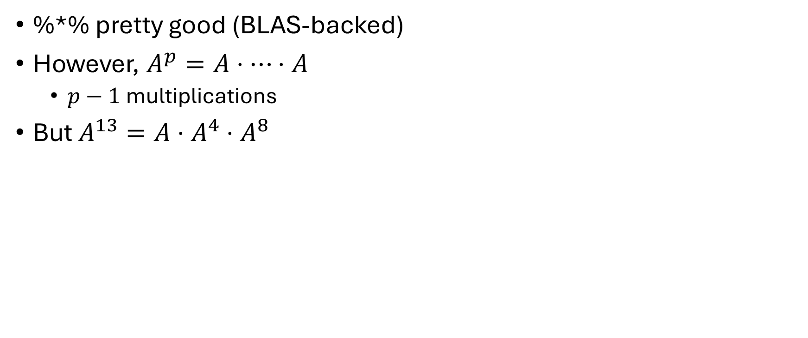
Optimize algorithm first!
%*% pretty good (BLAS-backed)
However, $A^{p}=A⋅⋯⋅A$
$p−1$ multiplications
But $A^{13}=A⋅A^{4}⋅A^{8}$
Binary multiplication 5 versus 12 multiplications!

Slide 87

If you don't profile…

Slide 88
I/O performance

Slide 89

Why worry?
Input/output takes time
Large data sets
Large files
Many files
File systems have characteristics
HPC file systems tuned for large read/writes

Slide 90
Many small read/writes
Metadata updates
Access time
Modification time
File size
Performance degradation for entire system/all users!

Slide 91
Types of data
Tabular data: .csv, …
Textual data: .txt, .json, …
Image data: .tiff, .jpeg, …
Video data: .mp4, .mov, …
…
Many small files ⇒ many metadata operations!

Slide 92
Solutions
Use binary data formats
Bundle small files into large ones
Read/write multiple items at once
Use caching
Use node-local scratch space (SSD drive)

Slide 93
Tabular data
Reading/writing CSV is very slow
Alternatives
Parquet files
I/O & space efficient
More CPU-intensive for (de)compression
Not optimal for random access
Arrow files
I/O efficient
In-memory format
Random access okay, sequential access very efficient
Can be used by R/pandas/pllars

Slide 94

Many text files
Use TAR, ZIP
Use Arrow/Hugging Face dataset
Read multiple "files"
Per operation

Slide 95
Many text files
E.g., random 200,000 reads of 100,000 files (< 1024 characters)
E.g., read 100,000 files (< 1024 characters)
method | Time (s) | Metadata IOPs
Naïve | 64.7 | 200,000
ZIP | 97.4 | 1
dataset | 22.7 | 3
method | Time (s) | Metadata IOPs
Naïve | 74.7 | 100,000
ZIP | 3.1 | 1
dataset | 17.2 | 3

Slide 96

Multi-dimensional arrays
HDF5
PyTorch/TensorFlow tensors in Arrow
Binary files
Don't use ASCII files

Slide 97
HDF5
Programming language agnostic
Cross platform
Self-documenting
Multiple datasets
Parallel I/O
Mostly for numerical data

Slide 98
HDF5 dataset layout
Matters a lot!
E.g., 10,000 random reads of 2,000 matrices (648 × 1152 × 4 uint8)
Layout | Time (s)
Row-major | 144.4
Column-major | 8,760.6
Stacked | 8,346.8

Slide 99

Image data
Many formats: JPEG, TIFF, PNG, …
Can be
Grayscale: 1D array
RGB or BGR: 3D array
RGB or BGR + alpha: 3D array
Store as
HDF5 file
PyTorch/TensorFlow tensor: Arrow

Slide 100

Arrow files
How? Use Hugging Face datasets library
Python only
Directory
Data: Arrow files
Metadata: JSON file
Easily split data into train and test
Easy to use with PyTorch/TensorFlow

Slide 101
Performance comparison for images
Contiguous read 2,000 images
Method | Time (s) | Metadata IOPs
Naïve | 12.6 | 2000
HDF5 | 15.7 | 1
dataset | 14.3 | 3
Reading many files ⇒ many metadata operations!

Slide 102
Local disks
Random 10,000 reads of 2,000 matrices (648 × 1152 × 4 uint8)
Scenario 1: read from lustre
Scenario 2: copy from lustre to local SSD, read from SSD
 | Scenario 1 |  | Scenario 2
Data format | Time (s) | Metadata IOPs | Time (s) | Metadata IOPs
Naïve | 42.2 | 10,000 | 11.0 + 36.9 | 2,000
HDF5 | 144.4 | 1 | 10.6 + 41.2 | 1
dataset | 64.5 | 3 | 17.0 + 52.4 | 3

Slide 103
Application environments & I/O
Problem with R/Python
Scripts load many modules/packages ⇒ many metadata operations!
Solution: use containers
Apptainer is supported on VSC systems
Comparison
Lmod load + Python module load: 14 s + gazillion metadata IOPs
Start container (3 GB image) + Python module load: 7 s + 1 metadata IOP
https://gjbex.github.io/Containers-for-HPC/

Slide 104
Wrap up

Slide 105

Conclusions
HPC supports data science
There is a learning curve
There is support
There is training

Slide 106
Where to go from here?
Workflows for HPC
Containers on HPC
Scientific Python
Python for data science
Python for HPC
Python on GPUs
Machine learning with Python
Deploying LLMs locally
C/C++/Fortran
Parallel programming
GPU programming

